Slide 1



Data Structure
&
Algorithm
Class IX
lab 8

Slide 2

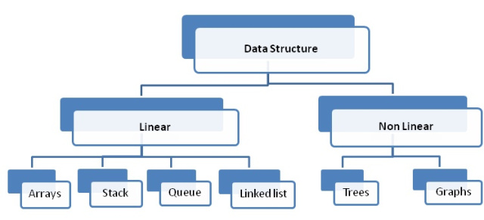
Data Structure
Linear data structures maintain their data in an ordered fashion

Slide 3
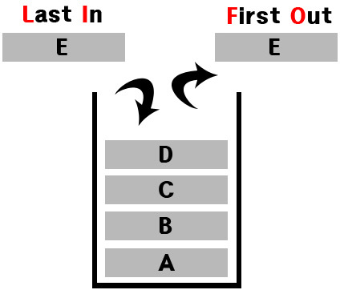
LIFO
Stack maintains
Last In Fast Out

Slide 4
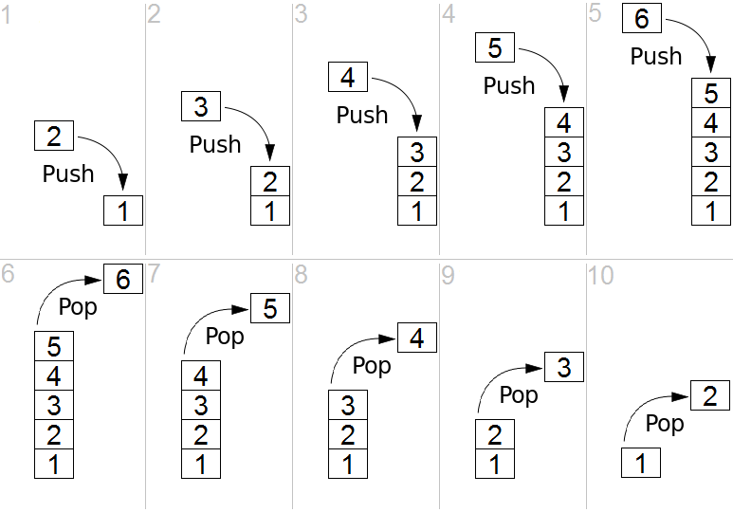
PUSH / POP
fundamental
operations for
a stack

Slide 5
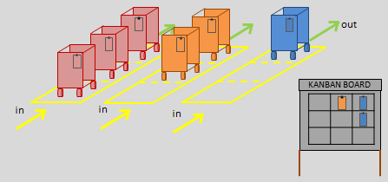
FIFO
Queue maintains
Fast in Fast Out

Slide 6
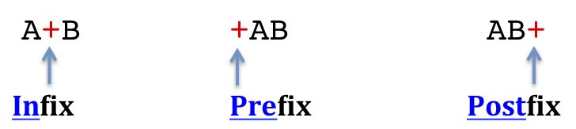
Infix/Prefix/Postfix
ways to write expressions

Slide 7
Infix/Prefix/Postfix
ways to write expressions

Slide 8
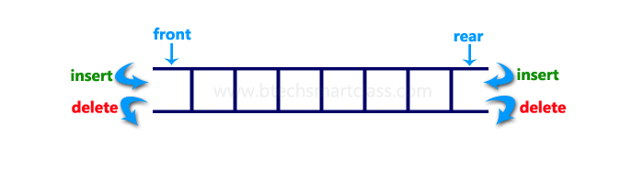
Deque
A deque, also known as a double-ended queue, is an ordered collection of items similar to the queue

Slide 9
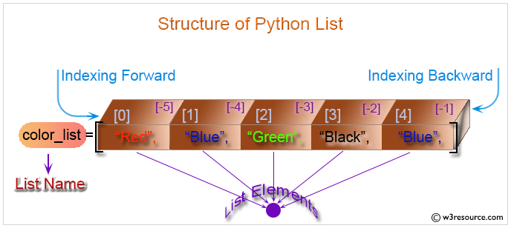
Lists
Lists are collections of items where each item holds a relative position.

Slide 10
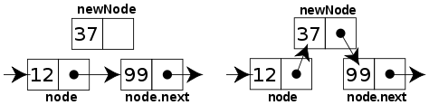
Linked Lists
A linked list implementation maintains logical order without requiring physical storage requirements

Slide 11


